Slide 1
Chapter 2: Relational Model
Notes:
1

Slide 2
Chapter 2: Relational Model
Advantages of Relational Model
Structure of Relational Databases
Fundamental Relational-Algebra-Operations
Additional Relational-Algebra-Operations
Extended Relational-Algebra-Operations
Null Values
Modification of the Database
Notes:
2

Slide 3
Advantages of Relational Model
Simplicity
Avoids data duplication.
Avoids inconsistent records.
Easier to change data
Easier to change data format
Data can be added and removed safely
Easier to maintain security
Provides a very simple yet powerful way to represent data

Slide 4
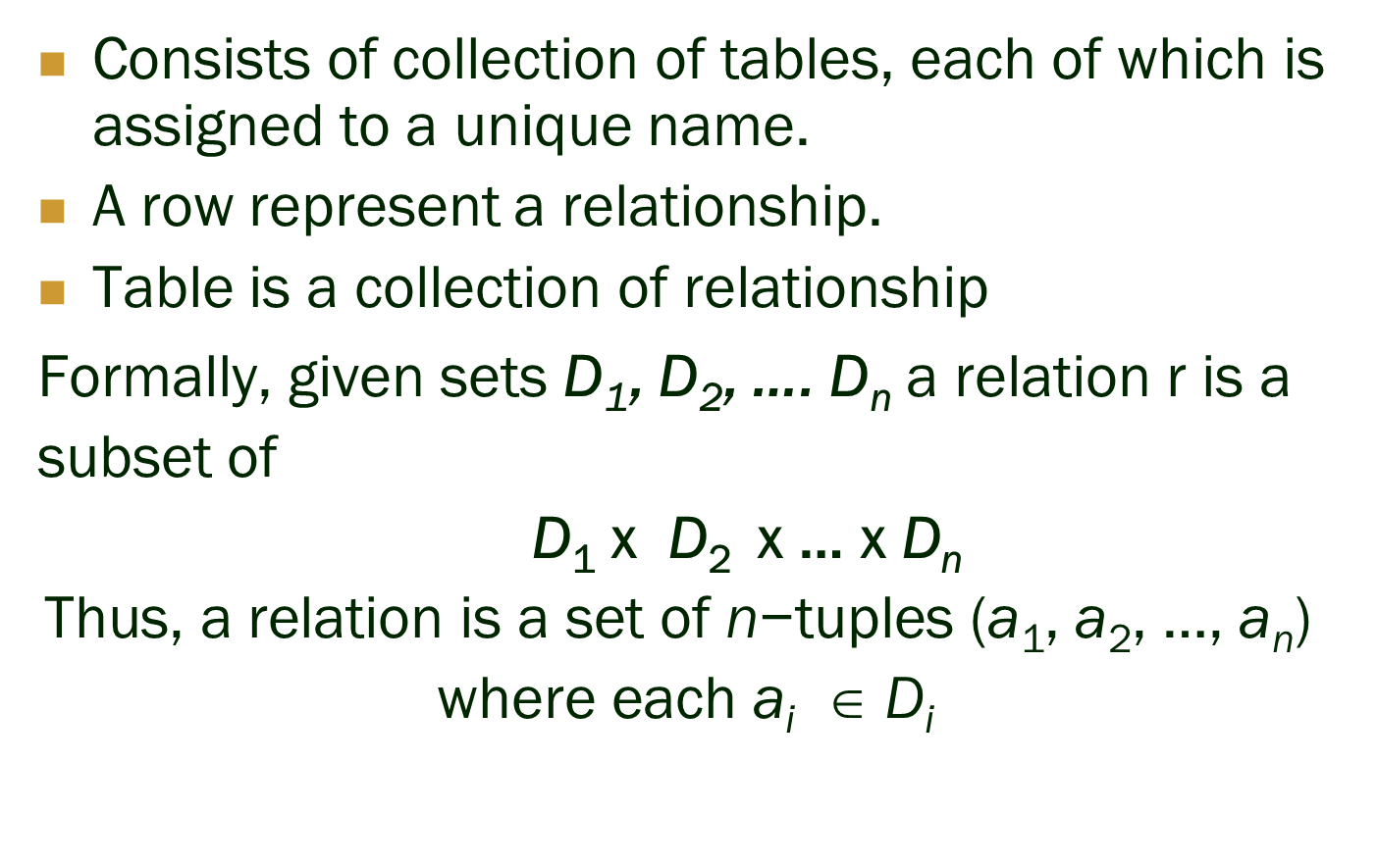
Structure of Relational Databases

Slide 5
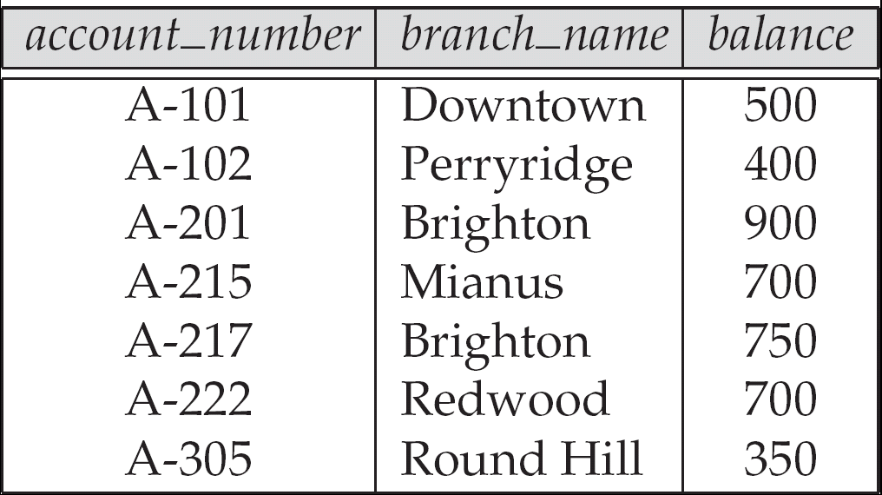
Example of a Relation

Slide 6
Basic Structure
Example: If
= customer_name = {Jones, Smith, Curry, Lindsay, …}
= customer_street = {Main, North, Park, …}
= customer_city = {Harrison, Rye, Pittsfield, …}
Then r = {
(Jones, Main, Harrison), (Smith, North, Rye), (Curry, North, Rye), (Lindsay, Park, Pittsfield)
} is a relation over
customer_name x customer_street x customer_city

Slide 7
Attribute Types
Each attribute of a relation has a name
The set of allowed values for each attribute is called the domain of the attribute
Attribute values are (normally) required to be atomic; that is, indivisible
E.g. the value of an attribute can be an account number, but cannot be a set of account numbers
Domain is said to be atomic if all its members are atomic
The special value null is a member of every domain
The null value causes complications in the definition of many operations
We shall ignore the effect of null values in our main presentation and consider their effect later

Slide 8
Relation Schema
A₁, A₂, …, A_{n} are attributes
R = (A₁, A₂, …, A_{n} ) is a relation schema
Example:
Customer_schema = (customer_name, customer_street, customer_city)
r(R) denotes a relation r on the relation schema R
Example:
customer (Customer_schema)

Slide 9
Relation Instance
The current values (relation instance) of a relation are specified by a table
An element t of r is a tuple, represented by a row in a table
attributes
(or columns)
customer_name
customer_street
customer_city
Jones
Smith
Curry
Lindsay
Main
North
North
Park
Harrison
Rye
Rye
Pittsfield
tuples
(or rows)
customer

Slide 10
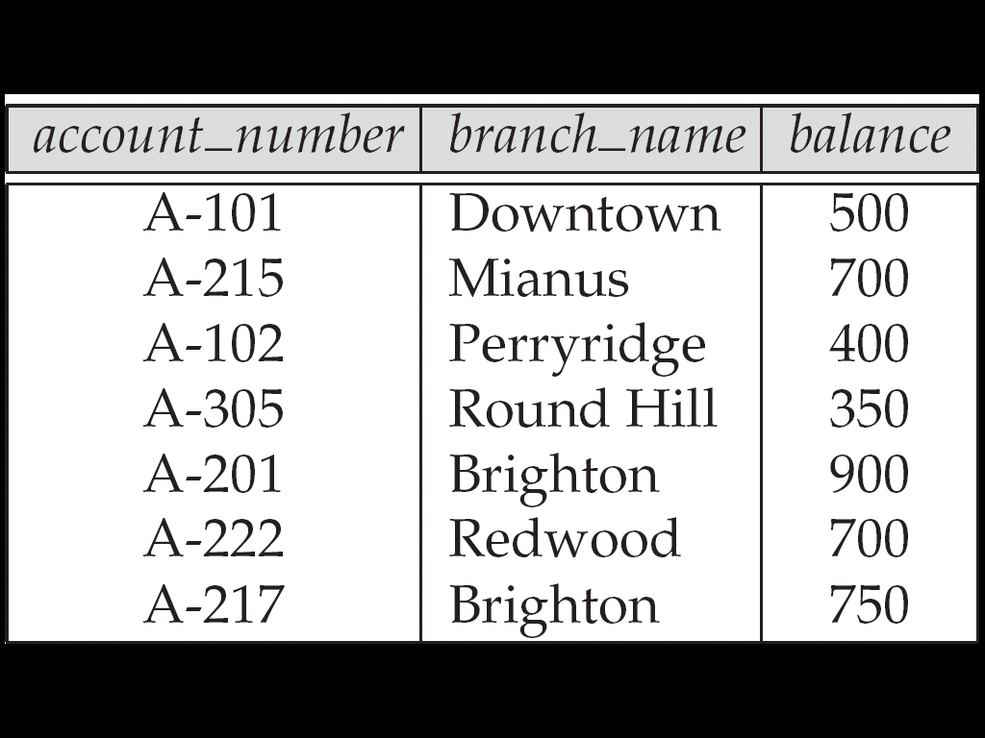
Relations are Unordered
Order of tuples is irrelevant (tuples may be stored in an arbitrary order)
Example: account relation with unordered tuples

Slide 11
Database
A database consists of multiple relations
Information about an enterprise is broken up into parts, with each relation storing one part of the information
account : stores information about accounts depositor : stores information about which customer owns which account customer : stores information about customers
Storing all information as a single relation such as bank(account_number, balance, customer_name, ..) results in
repetition of information
e.g.,if two customers own an account (What gets repeated?)
the need for null values
e.g., to represent a customer without an account
Normalization theory (Chapter 7) deals with how to design relational schemas

Slide 12
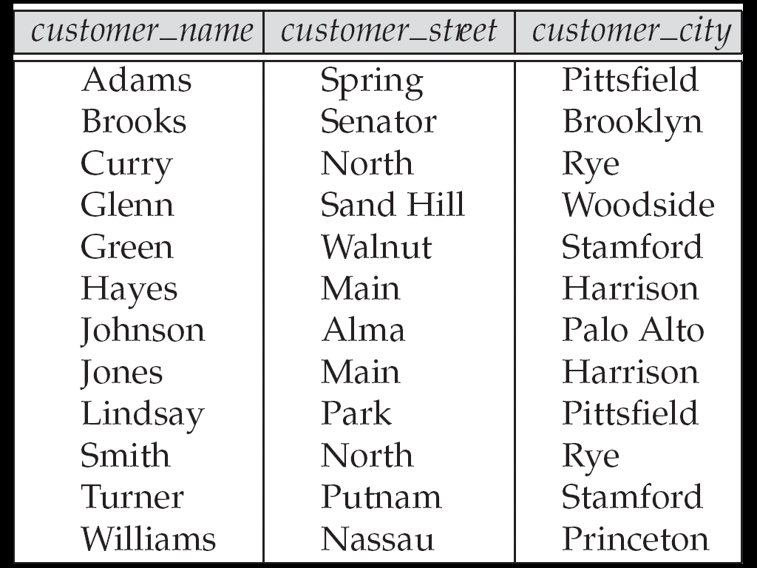
The customer Relation

Slide 13
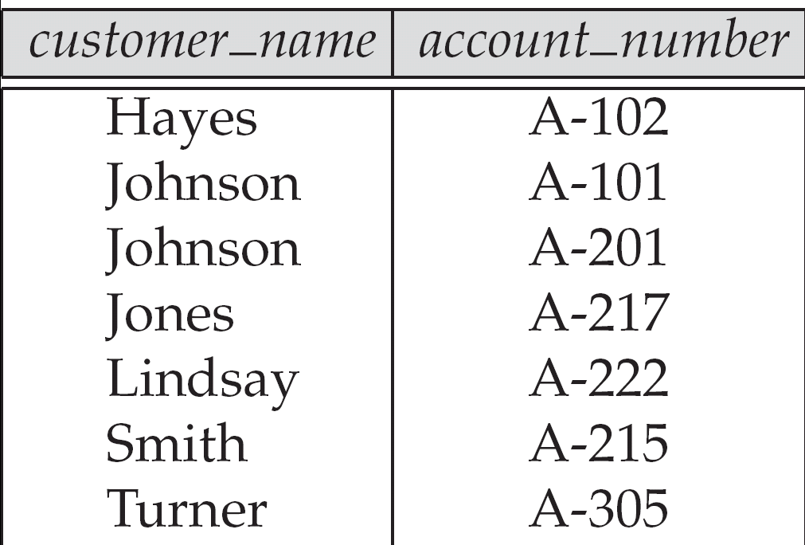
The depositor Relation

Slide 14
Keys
Let K ⊆ R
K is a superkey of R if values for K are sufficient to identify a unique tuple of each possible relation r(R)
by “possible r ” we mean a relation r that could exist in the enterprise we are modeling.
Example: {customer_name, customer_street} and {customer_name} are both superkeys of Customer, if no two customers can possibly have the same name
In real life, an attribute such as customer_id would be used instead of customer_name to uniquely identify customers, but we omit it to keep our examples small, and instead assume customer names are unique.

Slide 15
Keys (Cont.)
K is a candidate key if K is minimal Example: {customer_name} is a candidate key for Customer, since it is a superkey and no subset of it is a superkey.
Primary key: a candidate key chosen as the principal means of identifying tuples within a relation
Should choose an attribute whose value never, or very rarely, changes.
E.g. email address is unique, but may change

Slide 16
Foreign Keys
A relation schema may have an attribute that corresponds to the primary key of another relation. The attribute is called a foreign key.
E.g. customer_name and account_number attributes of depositor are foreign keys to customer and account respectively.
Only values occurring in the primary key attribute of the referenced relation may occur in the foreign key attribute of the referencing relation.

Slide 17
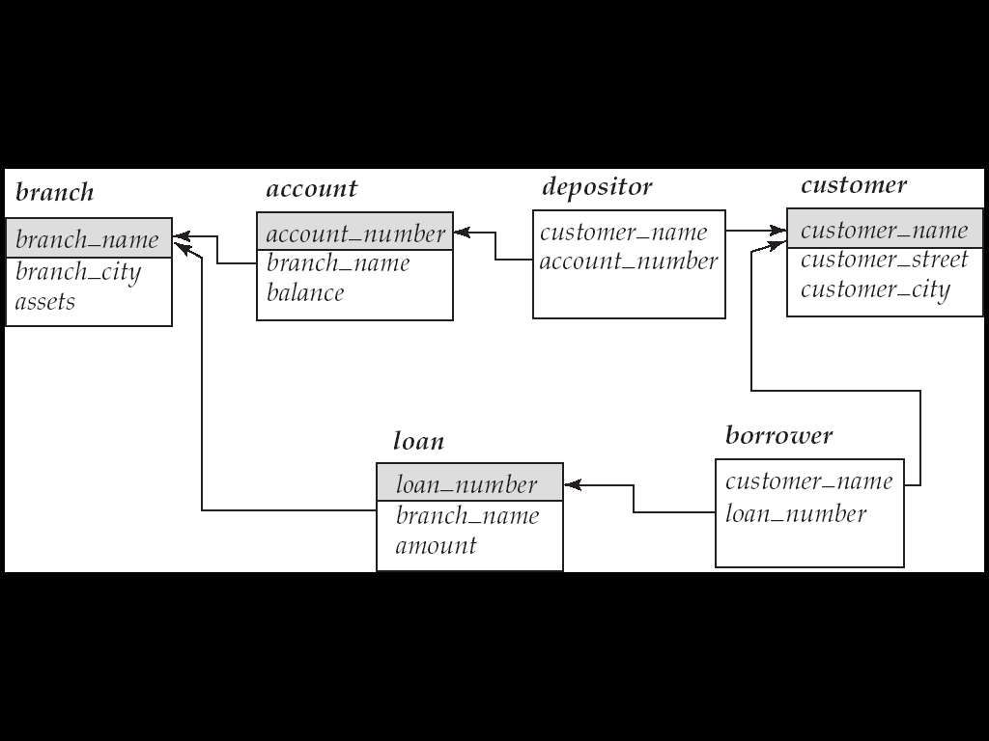
Schema diagram

Slide 18
Query Languages
Language in which user requests information from the database.
Categories of languages
Procedural
Non-procedural, or declarative SQL
“Pure” languages:
Relational algebra
Tuple relational calculus
Domain relational calculus
Pure languages form underlying basis of query languages that people use.

Slide 19
Relational Algebra
Procedural language
Six basic operators
select: σ
project: ∏
union: ∪
set difference: –
Cartesian product: x
rename: ρ
The operators take one or two relations as inputs and produce a new relation as a result.

Slide 20
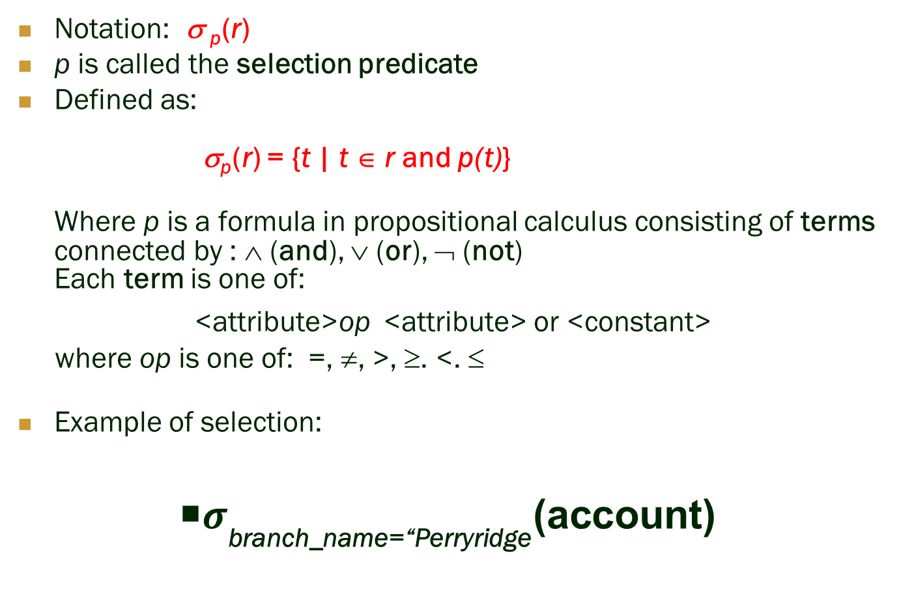
Select Operation

Slide 21
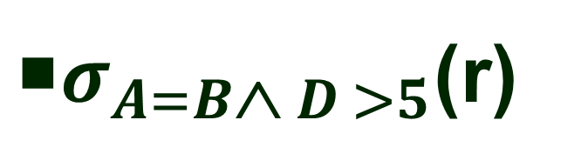
Select Operation – Example
Relation r
A
B
C
D
α
α
β
β
α
β
β
β
1
5
12
23
7
7
3
10
A
B
C
D
α
β
α
β
1
23
7
10

Slide 22
Project Operation
Notation:
where A₁, A₂ are attribute names and r is a relation name.
The result is defined as the relation of k columns obtained by erasing the columns that are not listed
Duplicate rows removed from result, since relations are sets
Example: To eliminate the branch_name attribute of account ∏_{account_number, balance} (account)

Slide 23
Project Operation – Example
A
B
C
Relation r:
α
α
β
β
10
20
30
40
1
1
1
2
A
C
A
C
∏_{A,C} (r)
α
α
β
β
1
1
1
2
α
β
β
1
1
2
=

Slide 24
Union Operation
Notation: r ∪ s
Defined as:
r ∪ s = {t | t ∈ r or t ∈ s}
For r ∪ s to be valid.
r, s must have the same arity (same number of attributes)
The attribute domains must be compatible (example: 2nd column of r deals with the same type of values as does the 2nd column of s)
Example: to find all customers with either an account or a loan ∏_{customer_name} (depositor) ∪ ∏_{customer_name} (borrower)

Slide 25
Union Operation – Example
Relations r, s:
A
B
A
B
α
α
β
1
2
1
α
β
2
3
s
r
A
B
α
α
β
β
1
2
1
3
r ∪ s:

Slide 26
Set Difference Operation
Notation r – s
Defined as:
r – s = {t | t ∈ r and t ∉ s}
Set differences must be taken between compatible relations.
r and s must have the same arity
attribute domains of r and s must be compatible

Slide 27
Set Difference Operation – Example
Relations r, s:
A
B
A
B
α
α
β
1
2
1
α
β
2
3
s
r
r – s:
A
B
α
β
1
1

Slide 28
Cartesian-Product Operation
Notation r x s
Defined as:
r x s = {t q | t ∈ r and q ∈ s}
Assume that attributes of r(R) and s(S) are disjoint. (That is, R ∩ S = ∅).
If attributes of r(R) and s(S) are not disjoint, then renaming must be used.

Slide 29
Cartesian-Product Operation – Example
Relations r, s:
A
B
C
D
E
α
β
1
2
α
β
β
γ
10
10
20
10
a
a
b
b
r
s
r x s:
A
B
C
D
E
α
α
α
α
β
β
β
β
1
1
1
1
2
2
2
2
α
β
β
γ
α
β
β
γ
10
10
20
10
10
10
20
10
a
a
b
b
a
a
b
b

Slide 30
Composition of Operations
Can build expressions using multiple operations
Example: σ_{A=C}(r x s)
r x s
σ_{A=C}(r x s)
A
B
C
D
E
α
α
α
α
β
β
β
β
1
1
1
1
2
2
2
2
α
β
β
γ α
β
β
γ
10
10
20
10
10
10
20
10
a
a
b
b
a
a
b
b
A
B
C
D
E
α
β
β
1
2
2
α
β
β
10
10
20
a
a
b

Slide 31
Rename Operation
Allows us to name, and therefore to refer to, the results of relational-algebra expressions.
Allows us to refer to a relation by more than one name.
Example:
ρ _{x} (E)
returns the expression E under the name X
If a relational-algebra expression E has arity n, then
returns the result of expression E under the name X, and with the
attributes renamed to A₁ , A₂ , …., A_{n} .

Slide 32
Example
Bars( name, addr )
Joe’s Maple St.
Sue’s River Rd.
R(bar, addr) := Bars
R( bar, addr )
Joe’s Maple St.
Sue’s River Rd.
32

Slide 33
Banking Example
branch (branch_name, branch_city, assets)
customer (customer_name, customer_street, customer_city)
account (account_number, branch_name, balance)
loan (loan_number, branch_name, amount)
depositor (customer_name, account_number)
borrower (customer_name, loan_number)

Slide 34
Example Queries
Find all loans of over $1200
σ_{amount > 1200} (loan)
Find the loan number for each loan of an amount greater than $1200
∏_{loan_number} (σ_{amount} _{> 1200} (loan))
Find the names of all customers who have a loan, an account, or both, from the bank
∏_{customer_name} (borrower) ∪ ∏_{customer_name} (depositor)

Slide 35
Example Queries
Find the names of all customers who have a loan at the Perryridge branch.
∏_{customer_name} (σ_{branch_name=“Perryridge”}
(σborrower.loan_number = loan.loan_number(borrower x loan)))
Find the names of all customers who have a loan at the Perryridge branch but do not have an account at any branch of the bank.
∏_{customer_name} (σ_{branch_name = “Perryridge”}
(σborrower.loan_number = loan.loan_number(borrower x loan))) – ∏_{customer_name}(depositor)

Slide 36
Example Queries
Find the names of all customers who have a loan at the Perryridge branch.
Query 1 ∏_{customer_name} (σ_{branch_name = “Perryridge”} ( σborrower.loan_number = loan.loan_number (borrower x loan)))
Query 2
∏_{customer_name}(σloan.loan_number = borrower.loan_number ( (σ_{branch_name = “Perryridge”} (loan)) x borrower))

Slide 37
Example Queries
Find the largest account balance
Strategy:
Find those balances that are not the largest
Rename account relation as d so that we can compare each account balance with all others
Use set difference to find those account balances that were not found in the earlier step.
The query is:
∏_{balance}(account) - ∏_{account.balance}
(σ_{account.balance < d.balance} (account x ρ_{d} (account)))

Slide 38
Formal Definition
A basic expression in the relational algebra consists of either one of the following:
A relation in the database
A constant relation
Let E₁ and E₂ be relational-algebra expressions; the following are all relational-algebra expressions:
E₁ ∪ E₂
E₁ – E₂
E₁ x E₂
σ_{p} (E₁), P is a predicate on attributes in E₁
∏_{s}(E₁), S is a list consisting of some of the attributes in E₁
ρ _{x} (E₁), x is the new name for the result of E₁

Slide 39
Additional Operations
We define additional operations that do not add any power to the relational algebra, but that simplify common queries.
Set intersection
Natural join
Division
Assignment

Slide 40
Set-Intersection Operation
Notation: r ∩ s
Defined as:
r ∩ s = { t | t ∈ r and t ∈ s }
Assume:
r, s have the same arity
attributes of r and s are compatible
Note: r ∩ s = r – (r – s)

Slide 41
Set-Intersection Operation – Example
Relation r, s:
r ∩ s
A B
A B
α
α
β
1
2
1
α
β
2
3
r
s
A B
α 2

Slide 42
Natural-Join Operation
Notation: r s
Let r and s be relations on schemas R and S respectively. Then, r s is a relation on schema R ∪ S obtained as follows:
Consider each pair of tuples t_{r} from r and t_{s} from s.
If t_{r} and t_{s} have the same value on each of the attributes in R ∩ S, add a tuple t to the result, where
t has the same value as t_{r} on r
t has the same value as t_{s} on s
Example:
R = (A, B, C, D)
S = (E, B, D)
Result schema = (A, B, C, D, E)
r s is defined as: ∏_{r.A, r.B, r.C, r.D, s.E} (σ_{r.B = s.B} ∧ _{r.D = s.D} (r x s))

Slide 43
Natural Join Operation – Example
Relations r, s:
A
B
C
D
B
D
E
α
β
γ
α
δ
1
2
4
1
2
α
γ
β
γ
β
a
a
b
a
b
1
3
1
2
3
a
a
a
b
b
α
β
γ
δ
∈
r
s
A
B
C
D
E
r s
α
α
α
α
δ
1
1
1
1
2
α
α
γ
γ
β
a
a
a
a
b
α
γ
α
γ
δ

Slide 44
Division Operation
r ÷ s
Notation:
Suited to queries that include the phrase “for all”.
Let r and s be relations on schemas R and S respectively where
R = (A₁, …, A_{m} , B₁, …, B_{n} )
S = (B₁, …, B_{n})
The result of r ÷ s is a relation on schema
R – S = (A₁, …, A_{m})
r ÷ s = { t | t ∈ ∏ _{R - S} (r) ∧ ∀ u ∈ s ( tu ∈ r ) }
Where tu means the concatenation of tuples t and u to produce a single tuple

Slide 45
Division Operation – Example
Relations r, s:
A
B
B
α
α
α
β
γ
δ
δ
δ
∈
∈
β
1
2
3
1
1
1
3
4
6
1
2
1
2
s
r ÷ s:
A
r
α
β

Slide 46
Another Division Example
Relations r, s:
A
B
C
D
E
D
E
α
α
α
β
β
γ
γ
γ
a
a
a
a
a
a
a
a
α
γ
γ
γ
γ
γ
γ
β
a
a
b
a
b
a
b
b
1
1
1
1
3
1
1
1
a
b
1
1
s
r
r ÷ s:
A
B
C
α
γ
a
a
γ
γ

Slide 47
Division Operation (Cont.)
Property
Let q = r ÷ s
Then q is the largest relation satisfying q x s ⊆ r
Definition in terms of the basic algebra operation Let r(R) and s(S) be relations, and let S ⊆ R
r ÷ s = ∏_{R-S} (r ) – ∏_{R-S} ( ( ∏_{R-S} (r ) x s ) – ∏_{R-S,S}(r ))
To see why
∏_{R-S,S} (r) simply reorders attributes of r
∏_{R-S} (∏_{R-S} (r ) x s ) – ∏_{R-S,S}(r) ) gives those tuples t in ∏_{R-S} (r ) such that for some tuple u ∈ s, tu ∉ r.

Slide 48
Assignment Operation
The assignment operation (←) provides a convenient way to express complex queries.
Write query as a sequential program consisting of
a series of assignments
followed by an expression whose value is displayed as a result of the query.
Assignment must always be made to a temporary relation variable.
Example: Write r ÷ s as
temp1 ← ∏_{R-S} (r ) temp2 ← ∏_{R-S} ((temp1 x s ) – ∏_{R-S,S} (r )) result = temp1 – temp2
The result to the right of the ← is assigned to the relation variable on the left of the ←.
May use variable in subsequent expressions.

Slide 49
Bank Example Queries
Find the names of all customers who have a loan and an account at bank.
∏_{customer_name} (borrower) ∩ ∏_{customer_name} (depositor)
Find the name of all customers who have a loan at the bank and the loan amount
∏customer_name, loan_number, amount (borrower loan)

Slide 50
Bank Example Queries
Find all customers who have an account from at least the “Downtown” and the Uptown” branches.
Query 1
∏_{customer_name} (σ_{branch_name = “Downtown”} (depositor account )) ∩
∏_{customer_name} (σ_{branch_name = “Uptown”} (depositor account))
Query 2
∏_{customer_name, branch_name} (depositor account) ÷ ρ_{temp(branch_name)} ({(“Downtown” ), (“Uptown” )})
Note that Query 2 uses a constant relation.

Slide 51
Bank Example Queries
Find all customers who have an account at all branches located in Brooklyn city.
∏_{customer_name, branch_name} (depositor account) ÷ ∏_{branch_name} (σ_{branch_city = “Brooklyn”} (branch))

Slide 52
Extended Relational-Algebra-Operations
Generalized Projection
Aggregate Functions
Outer Join
Notes:
52

Slide 53
Generalized Projection
Extends the projection operation by allowing arithmetic functions to be used in the projection list.
E is any relational-algebra expression
Each of F₁, F₂, …, F_{n} are arithmetic expressions involving constants and attributes in the schema of E.
Given relation credit_info(customer_name, limit, credit_balance), find how much more each person can spend:
∏customer_name, limit – credit_balance (credit_info)
Notes:
53

Slide 54
Aggregate Functions and Operations
Aggregation function takes a collection of values and returns a single value as a result.
avg: average value min: minimum value max: maximum value sum: sum of values count: number of values
Aggregate operation in relational algebra
E is any relational-algebra expression
G₁, G₂ …, G_{n} is a list of attributes on which to group (can be empty)
Each F_{i} is an aggregate function
Each A_{i} is an attribute name

Slide 55
Aggregate Operation – Example
Relation r:
A
B
C
α
α
β
β
α
β
β
β
7
7
3
10
g _{sum(c)} (r)
sum(c )
27

Slide 56
Aggregate Operation – Example
Relation account grouped by branch-name:
branch_name
account_number
balance
Perryridge
Perryridge
Brighton
Brighton
Redwood
A-102
A-201
A-217
A-215
A-222
400
900
750
750
700
_{branch_name} g _{sum(balance)} (account)
branch_name
sum(balance)
Perryridge
Brighton
Redwood
1300
1500
700

Slide 57
Aggregate Functions (Cont.)
Result of aggregation does not have a name
Can use rename operation to give it a name
For convenience, we permit renaming as part of aggregate operation
_{branch_name} g _{sum(balance) as sum_balance} (account)

Slide 58
Outer Join
An extension of the join operation that avoids loss of information.
Computes the join and then adds tuples form one relation that does not match tuples in the other relation to the result of the join.
Uses null values:
null signifies that the value is unknown or does not exist
All comparisons involving null are (roughly speaking) false by definition.
We shall study precise meaning of comparisons with nulls later

Slide 59
Outer Join – Example
Relation loan
loan_number
branch_name
amount
L-170
L-230
L-260
Downtown
Redwood
Perryridge
3000
4000
1700
Relation borrower
customer_name
loan_number
Jones
Smith
Hayes
L-170
L-230
L-155

Slide 60
Outer Join – Example
Join loan borrower
loan_number
branch_name
amount
customer_name
L-170
L-230
Downtown
Redwood
3000
4000
Jones
Smith
Left Outer Join
loan borrower
loan_number
branch_name
amount
customer_name
L-170
L-230
L-260
Downtown
Redwood
Perryridge
3000
4000
1700
Jones
Smith
null

Slide 61
Outer Join – Example
Right Outer Join
loan borrower
loan_number
branch_name
amount
customer_name
L-170
L-230
L-155
Downtown
Redwood
null
3000
4000
null
Jones
Smith
Hayes
Full Outer Join
loan borrower
loan_number
branch_name
amount
customer_name
L-170
L-230
L-260
L-155
Downtown
Redwood
Perryridge
null
3000
4000
1700
null
Jones
Smith
null
Hayes

Slide 62
Null Values
It is possible for tuples to have a null value, denoted by null, for some of their attributes
null signifies an unknown value or that a value does not exist.
The result of any arithmetic expression involving null is null.
Aggregate functions simply ignore null values (as in SQL)
For duplicate elimination and grouping, null is treated like any other value, and two nulls are assumed to be the same (as in SQL)

Slide 63
Null Values
Comparisons with null values return the special truth value: unknown
If false was used instead of unknown, then not (A < 5) would not be equivalent to A >= 5
Three-valued logic using the truth value unknown:
OR: (unknown or true) = true, (unknown or false) = unknown (unknown or unknown) = unknown
AND: (true and unknown) = unknown, (false and unknown) = false, (unknown and unknown) = unknown
NOT: (not unknown) = unknown
In SQL “P is unknown” evaluates to true if predicate P evaluates to unknown
Result of select predicate is treated as false if it evaluates to unknown
Notes:
63

Slide 64
Modification of the Database
The content of the database may be modified using the following operations:
Deletion
Insertion
Updating
All these operations are expressed using the assignment operator.

Slide 65
Deletion
A delete request is expressed similarly to a query, except instead of displaying tuples to the user, the selected tuples are removed from the database.
Can delete only whole tuples; cannot delete values on only particular attributes
A deletion is expressed in relational algebra by:
r ← r – E
where r is a relation and E is a relational algebra query.

Slide 66
Deletion Examples
Delete all account records in the Perryridge branch.
account ← account – σ _{branch_name = “Perryridge”} (account )
Delete all loan records with amount in the range of 0 to 50
loan ← loan – σ _{amount ≥ 0 and amount ≤ 50} (loan)
Delete all accounts at branches located in Needham.
r₁ ← σ _{branch_city = “Needham”} (account branch )
r₂ ← ∏ _{account_number,} _{branch_name, balance} (r₁)
r₃ ← ∏ _{customer_name, account_number} (r₂ depositor)
account ← account – r₂
depositor ← depositor – r₃

Slide 67
Insertion
To insert data into a relation, we either:
specify a tuple to be inserted
write a query whose result is a set of tuples to be inserted
in relational algebra, an insertion is expressed by:
r ← r ∪ E
where r is a relation and E is a relational algebra expression.
The insertion of a single tuple is expressed by letting E be a constant relation containing one tuple.

Slide 68
Insertion Examples
Insert information in the database specifying that Smith has $1200 in account A-973 at the Perryridge branch.
account ← account ∪ {(“A-973”, “Perryridge”, 1200)}
depositor ← depositor ∪ {(“Smith”, “A-973”)}
Provide as a gift for all loan customers in the Perryridge branch, a $200 savings account. Let the loan number serve as the account number for the new savings account.
r₁ ← (σ_{branch_name = “Perryridge”} (borrower loan))
account ← account ∪ ∏_{loan_number, branch_name, 200} (r₁)
depositor ← depositor ∪ ∏_{customer_name, loan_number} (r₁)

Slide 69
Updating
A mechanism to change a value in a tuple without charging all values in the tuple
Use the generalized projection operator to do this task
Each F_{i} is either
the I ^{th} attribute of r, if the I ^{th} attribute is not updated, or,
if the attribute is to be updated F_{i} is an expression, involving only constants and the attributes of r, which gives the new value for the attribute

Slide 70
Update Examples
Make interest payments by increasing all balances by 5 percent.
account ← ∏ account_number, branch_name, balance * 1.05 (account)
Pay all accounts with balances over $10,000 6 percent interest and pay all others 5 percent
account ← ∏ account_number, branch_name, balance * 1.06 (σ _{BAL > 10000} (account )) ∪ ∏ account_number, branch_name, balance * 1.05 (σ_{BAL ≤ 10000} (account))

Slide 71
End of Chapter 2

Slide 72
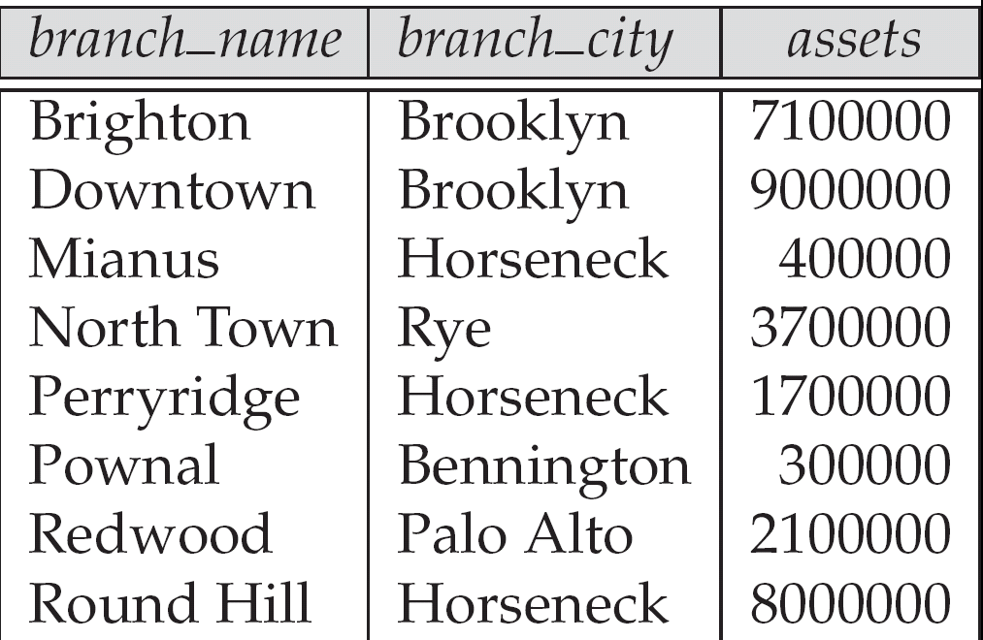
Figure 2.3. The branch relation

Slide 73
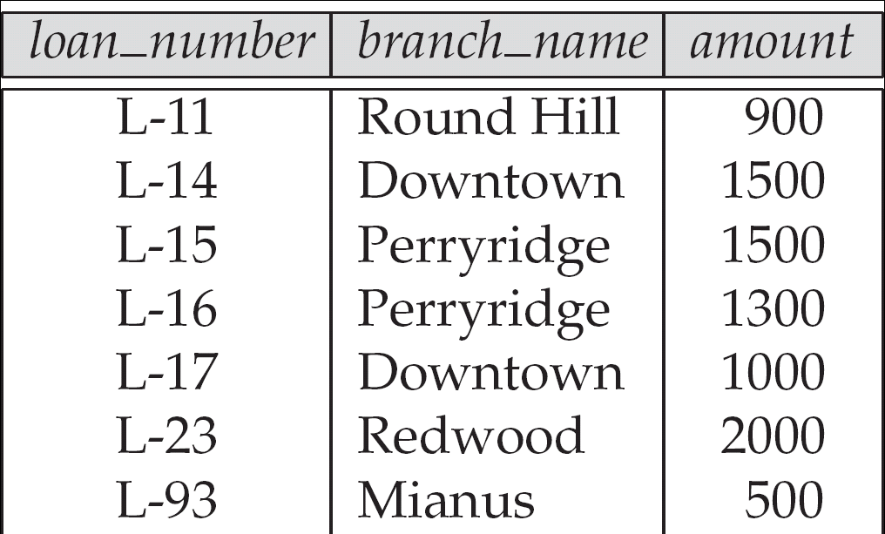
Figure 2.6: The loan relation

Slide 74
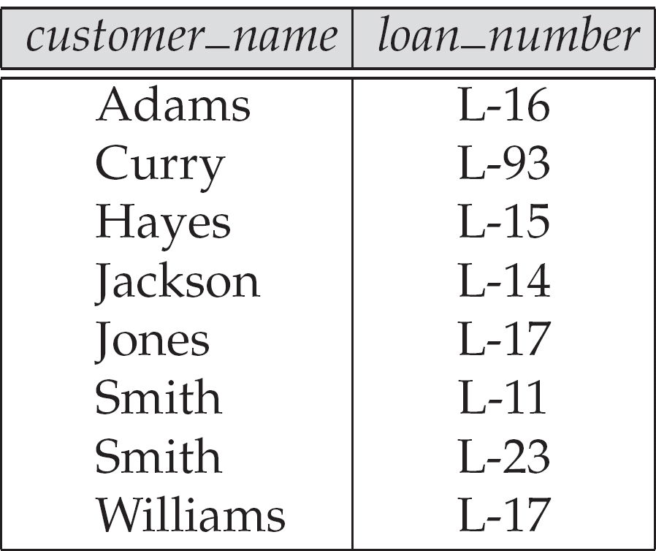
Figure 2.7: The borrower relation

Slide 75
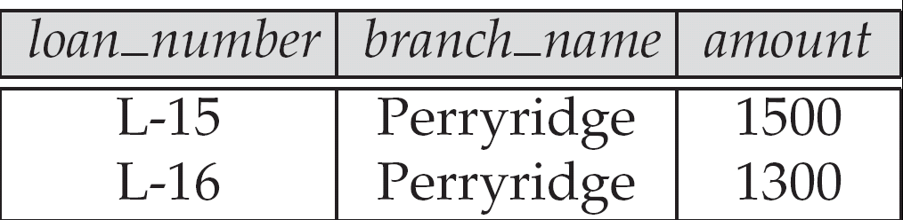
Figure 2.9 Result of σ_{branch_name = “Perryridge”} (loan)

Slide 76
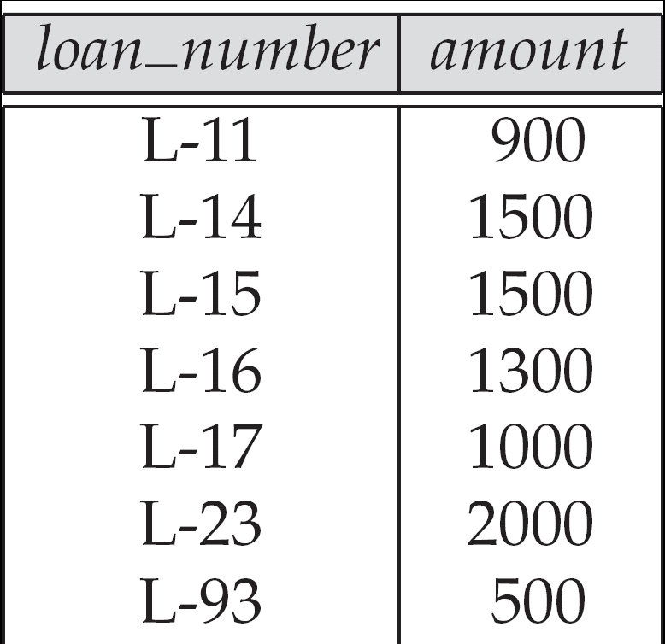
Figure 2.10: Loan number and the amount of the loan

Slide 77
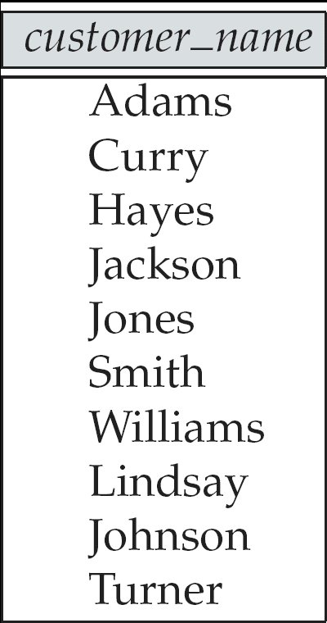
Figure 2.11: Names of all customers who have either an account or an loan

Slide 78
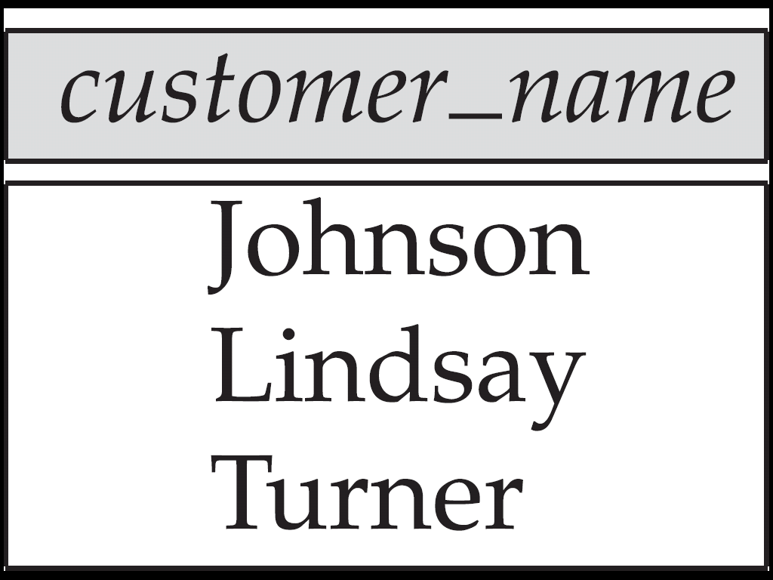
Figure 2.12: Customers with an account but no loan

Slide 79
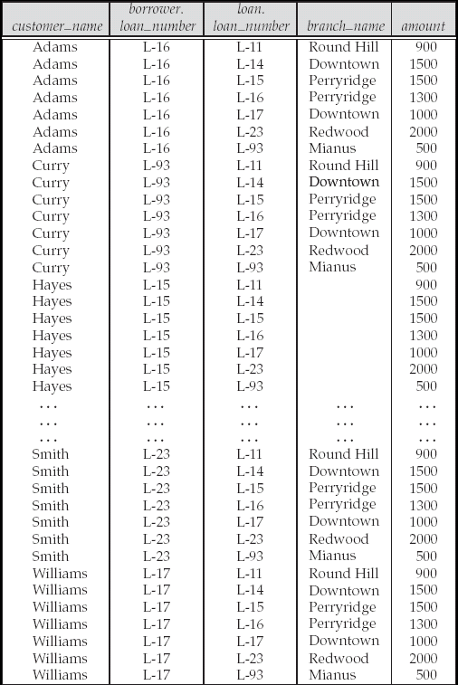
Figure 2.13: Result of borrower |X| loan

Slide 80
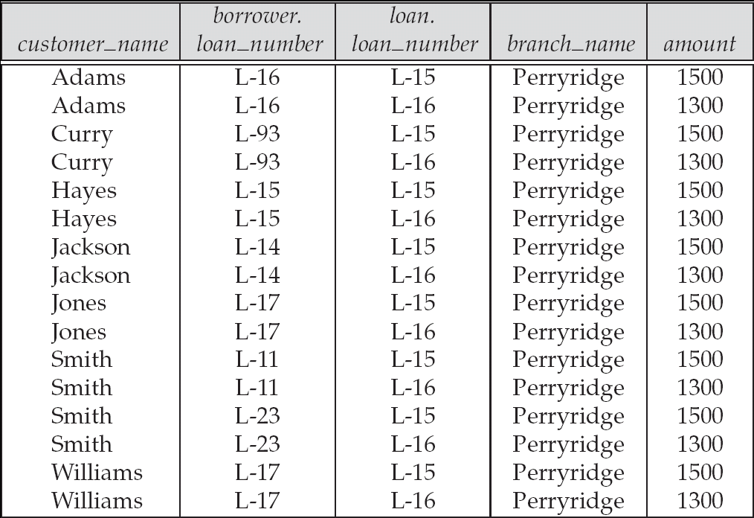
Figure 2.14

Slide 81
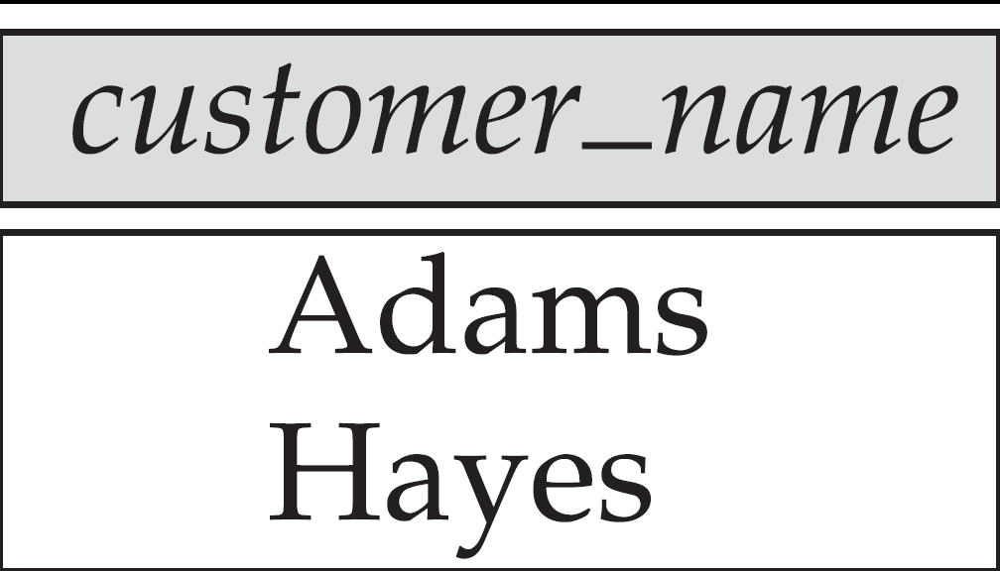
Figure 2.15

Slide 82
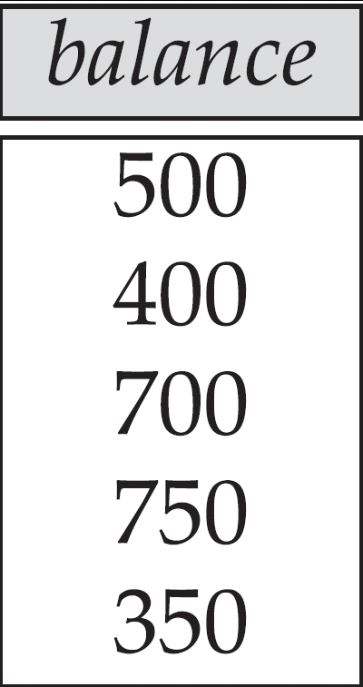
Figure 2.16

Slide 83
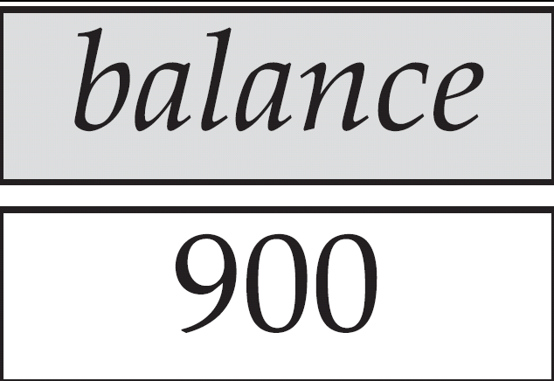
Figure 2.17 Largest account balance in the bank

Slide 84
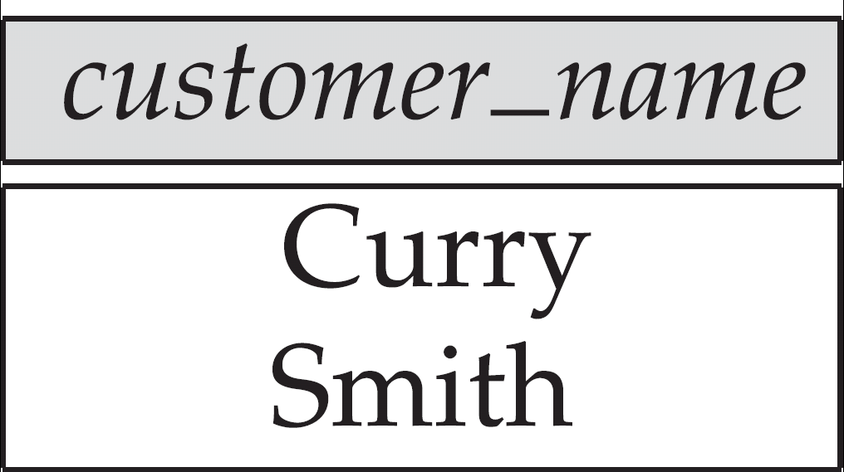
Figure 2.18: Customers who live on the same street and in the same city as Smith

Slide 85
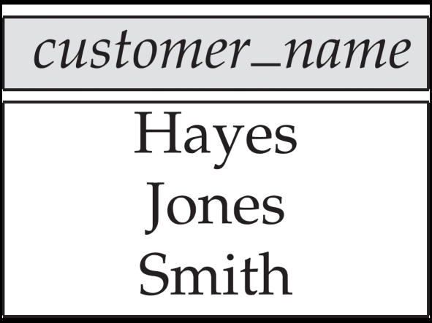
Figure 2.19: Customers with both an account and a loan at the bank

Slide 86
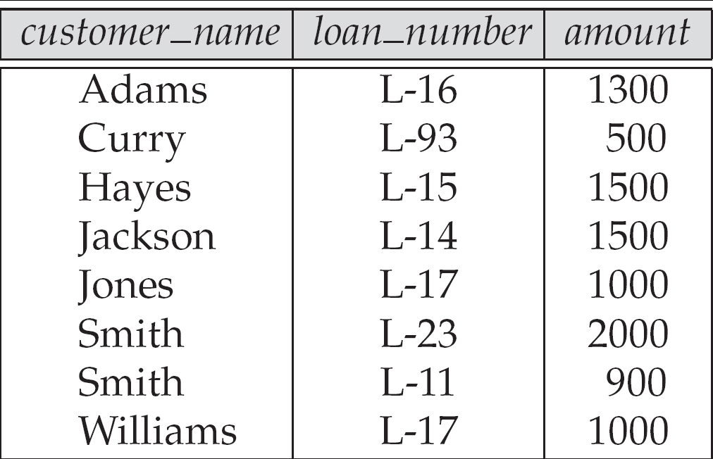
Figure 2.20

Slide 87
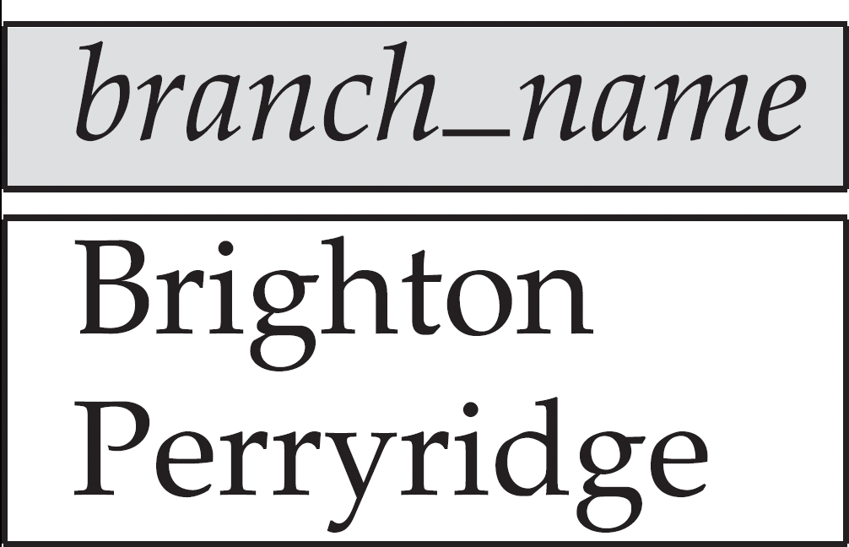
Figure 2.21

Slide 88
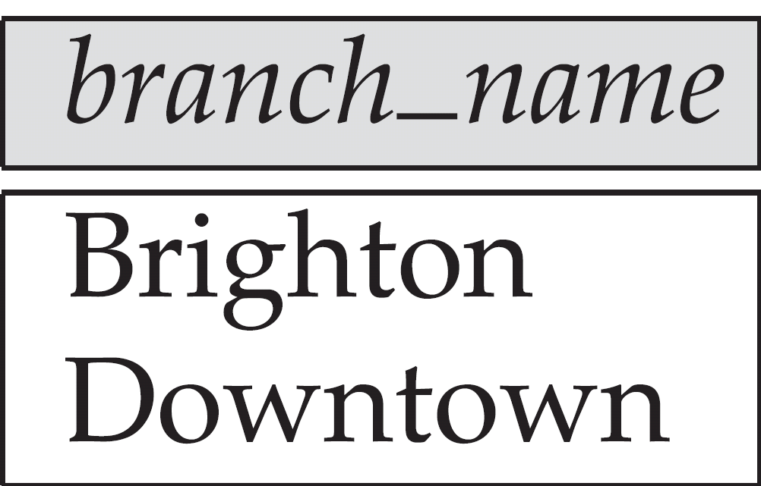
Figure 2.22

Slide 89
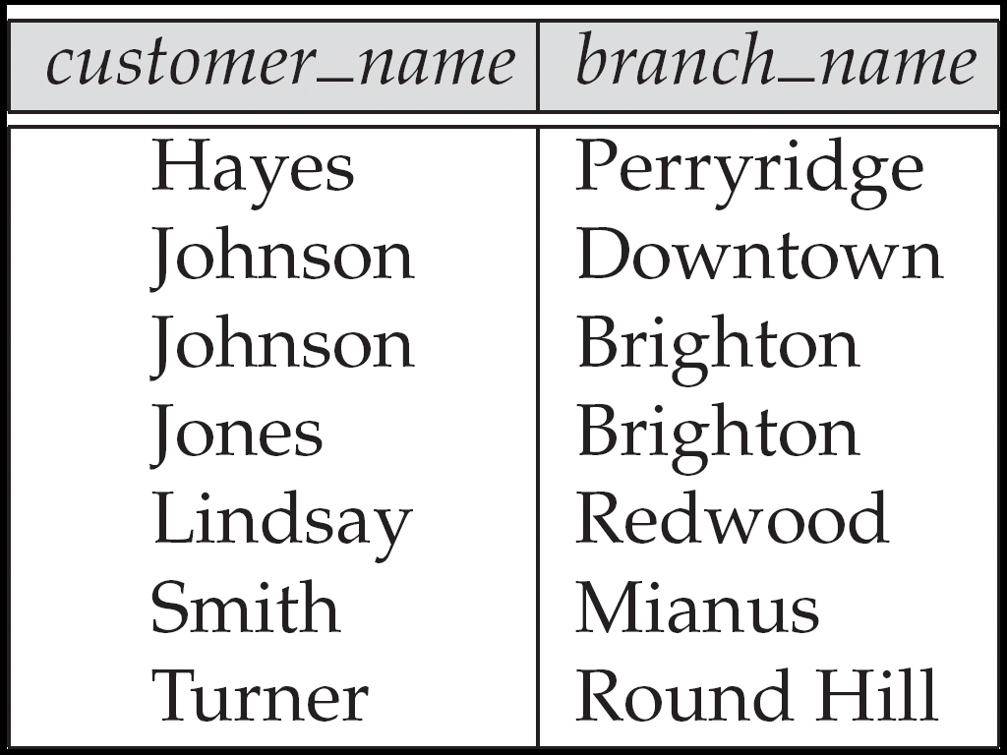
Figure 2.23

Slide 90
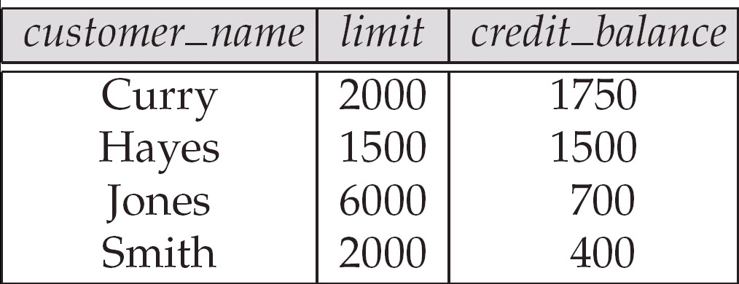
Figure 2.24: The credit_info relation

Slide 91
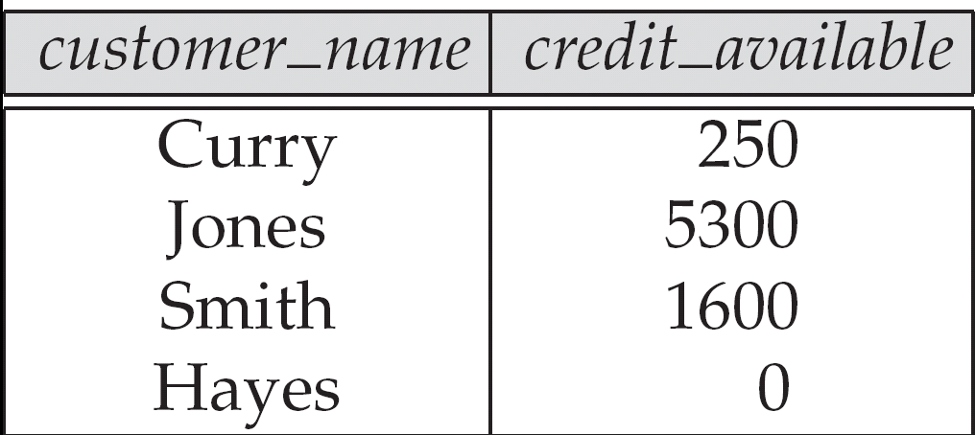
Figure 2.25

Slide 92
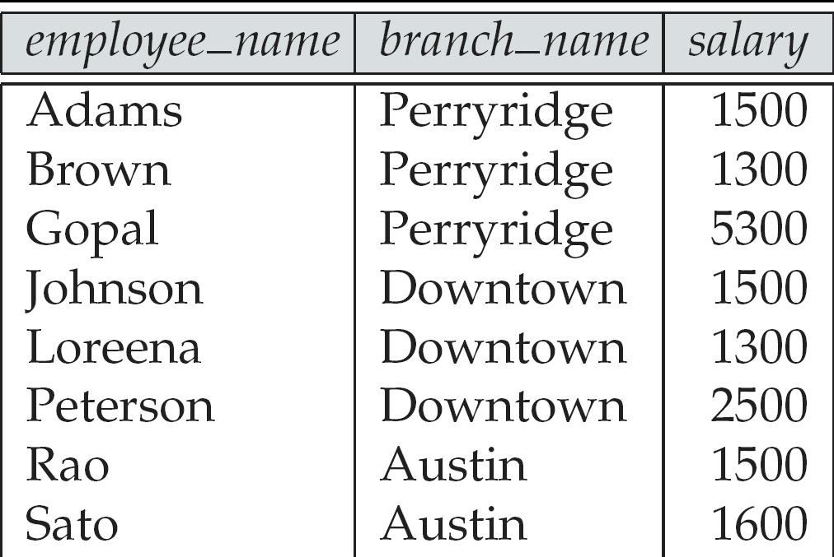
Figure 2.26: The pt_works relation

Slide 93
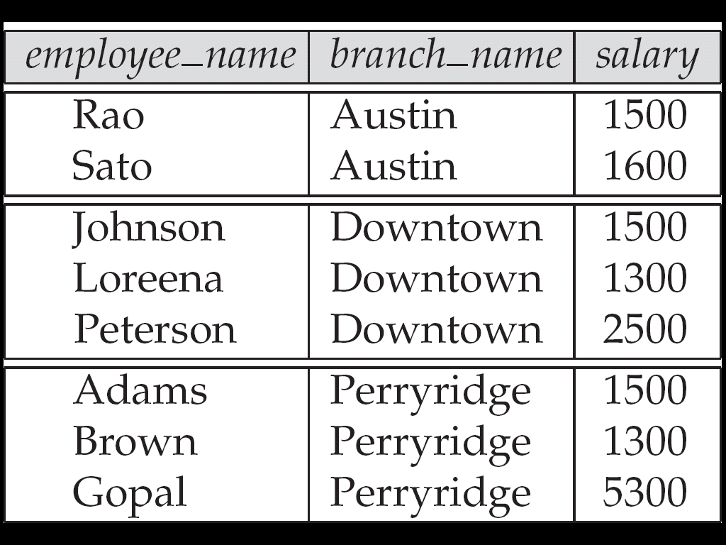
Figure 2.27 The pt_works relation after regrouping

Slide 94
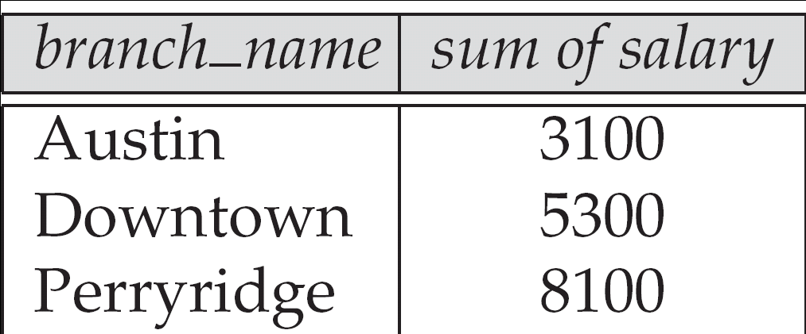
Figure 2.28

Slide 95
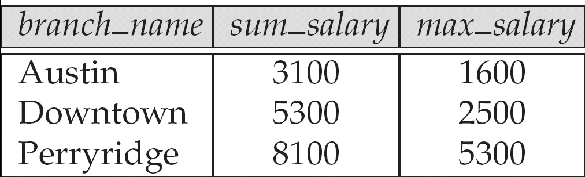
Figure 2.29

Slide 96
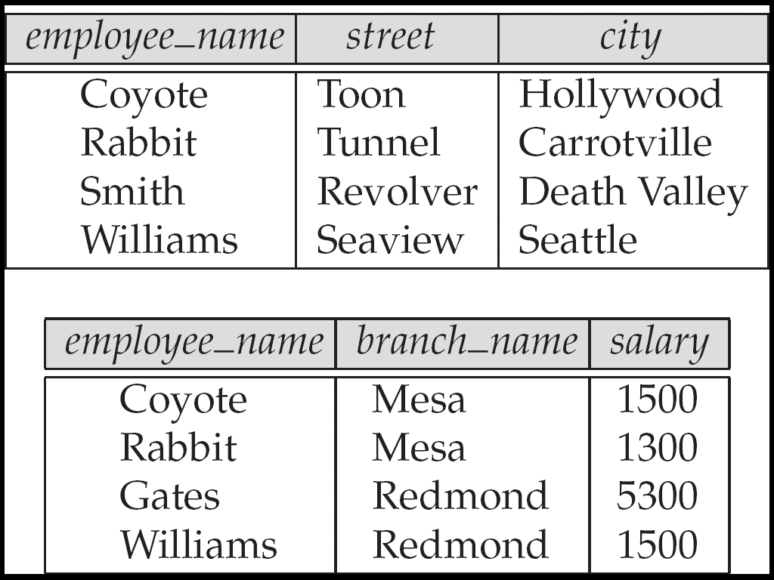
Figure 2.30 The employee and ft_works relations

Slide 97
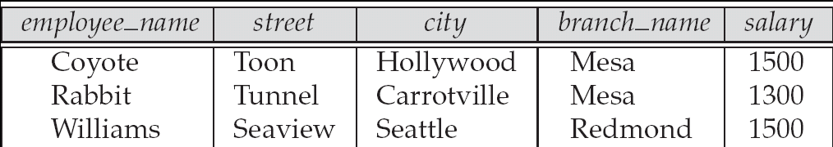
Figure 2.31

Slide 98
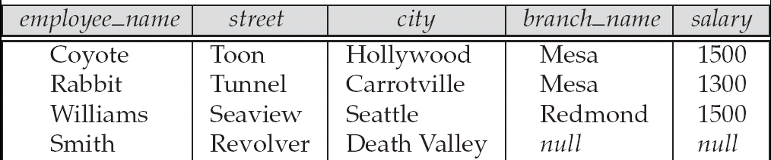
Figure 2.32

Slide 99
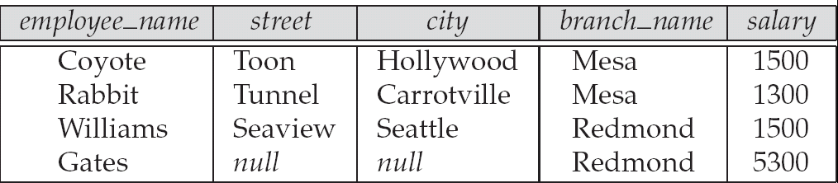
Figure 2.33

Slide 100
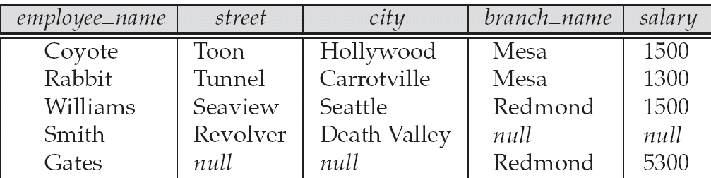
Figure 2.34

